Slide 1
Maintenance and Repair Methodology
メンテナンスと修理の方法
MSC ships follow a commercial maritime model for maintenance and repair with small crews, relying primarily on industrial assistance
MSCの船舶は、主に産業支援に依存し、少人数の乗組員でメンテナンス ・修理を行う商業海事モデルに従っている。
Ships are classed by the American Bureau of Shipping (ABS) and certificated by the US Coast Guard
船舶は米国船級協会（ABS）によってクラス分けされ、米国沿岸警備隊によって認証されている。
Ships have a 5-year Special Survey Cycle, Dry docking (or UWILD) the ship 2 times in 5 years
船舶には5年間の特別調査サイクルがあり、5年間に2回、ドライドックが行われる。

Slide 2
Maintenance and Repair Methodology
メンテナンスと修理の方法
Typical MSC Maintenance Schedule
  Quarterly Voyage Repair (VR) periods
  Alternating Annual Regular Overhaul/Dry-Docking and Mid-Term Availabilities
典型的なMSCのメンテナンス・スケジュール
  四半期ごとの航海修理期間
  年1回の定期オーバーホール／ドライ・ドックと中間メンテナンスを交互に実施
MSC has an aging fleet, with vessels operating past the design service life. An aging fleet it introduces many issues that are not typical with many commercial vessels. This includes material obsolescence, corrosion, fatigue, and having machinery hours past the OEM technical manuals.
MSCの船隊は老朽化しており、設計耐用年数を過ぎた船舶が稼働している。 老朽化した船隊は、多くの商業船にはない多くの問題を引き起こす。これには、材質の陳腐化、腐食、疲労、OEMの技術マニュアルを過ぎた機械の稼働時間などが含まれる。

Slide 3
T-AO Gap Mitigation
船舶の耐用年数延長計画
Ship 艦名 | Decom Date Shift 退役年の変更 | INACT Age 現役年数
Lenthall | FY23 to FY27 | 41
Grumman | FY25 to FY28 | 39
Humphreys | FY26 to FY29 | 43
Kanawha | FY29 to FY31 | 40
Guadalupe | FY30 to FY32 | 42
Yukon | FY33 to FY36 | 43
Laramie | FY35 to FY38 | 44
    T-AOs and T-AOEs Ready for Tasking
    作戦準備できた級給油艦
    (T-AO と T-AOE)
GRUMMAN
KANAWHA
GUADALUPE
LENTHALL
HUMPHREYS
YUKON
LARAMIE
Inventory after POM25 T-AO 205 Deferments (gray area)
T-AO 187 Extensions
    OPNAV Proposal with Slower 205 Class Procurement
    187 Class ESL 35 Years

Slide 4
Other Life Extension Plans
その他の船舶の耐用年数延長計画
Ship 艦名 | Decom Date 退役年の変更 | Age 現役年数
MT Whitney | FY26 to FY39 | 68
USNS Emory S. Land | FY31 to FY33 | 54
USNS Frank Cable | FY32 to FY34 | 55
USNS CATAWBA | FY24 to FY25 | 45
USNS GRASP | FY24 to FY26 | 41
USNS ZEUS | FY27 to FY31 | 47
CUI

Slide 5
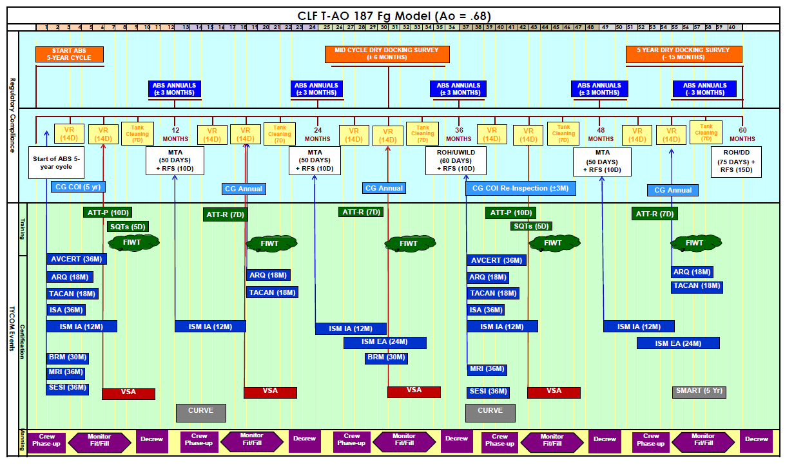
T-AO Fg Model

Slide 6
Maintenance Plans (Government-Owned/Government-Operated)
メンテナンス計画 (政府所有／政府運用)
Our standard logistics ship overhaul cycle includes:
標準的な級給油艦の整備サイクルには以下が含まれます:
Dry docking Availabilities every 2.5 years (60 - 120 days)
2.5年ごとの乾ドック(60日ー120 日)
Mid-term Availabilities every 18 months (45 - 60 days)
18ヶ月ごとの中間メンテナンス(45日ー60 日)
Quarterly Voyage Repair periods (2 weeks pier-side)
四半期ごとの航海修理期間(2週間桟橋側)
UNCLASSIFIED

Slide 7
Maintenance Plans (Government-Owned/Government-Operated)
メンテナンス計画 (政府所有／政府運用)
Inspections and Surveys at regular intervals:
定期的な点検・調査:
Continuous ABS surveys (5-year cycle)
継続的なABS調査(5年周期)
Annual USCG inspections
米国沿岸警備隊の年次検査
Ship Material Assessment and Readiness Testing (every 5 years by MSC engineers)
船舶材質の評価と準備試験 (MSCの技師が5年ごとに実施)
Annual Safety Management and Environmental Audits
年次安全管理・環境監査
Continuous maintenance pier-side whenever practical
桟橋側での継続的なメンテナンス
Note: High-Speed Vessels require annual dry-docking
注：高速船は年1回の乾ドックが必要である。

Slide 8
Maintenance Planning
メンテナンス計画
Identify Issues Early
問題を早期に発見する
  Instituted government material condition surveys SMART, PEVI, VSA, Corrosion and Load-line assessments, Material Readiness Inspections
  政府の資材状況調査を実施 SMART, PEVI, VSA, 腐食と載貨喫水線評価, 資材準備検査
    SMART/VSA – Testing and evaluation of machinery and systems
    SMART/VSA – 機械およびシステムの点検・評価
    PEVI – Static examination of the vessel by the Principal Port Engineer to evaluate hull, structures, coating condition, main and auxiliary spaces.
    PEVI – 港湾技師長による、船体、構造物、塗装の状態、船内および補助室を評価するための静的検査
  3rd party oversight ABS Annuals and USCG COI
  第三者監視 ABS年次報告書および米国沿岸警備隊のCOI

Slide 9
Maintenance Planning
メンテナンス計画
Advanced Planning and Package Development
事前に計画開発
  MSC goal is to have work package assembly and material order requests for the next 3 to 5 years for all major availabilities.
  MSCの目標は、すべての大規模修繕期間について、今後3～5年間の作業計画と資材発注依頼書を作成することである。

Slide 10
Maintenance Planning
メンテナンス計画
  Package includes standard work items, cross class and class standard work items.
  作業計画には、標準作業項目、船級標準作業項目が含まれる。
    SWI/CCSI/CSIs constitute 80% of the work package.
    SWI/CCSI/CSIが作業計画の80％を占める.
    Repair items constitute 15% of the work package and these are items that are identified through ship’s force and material assessments. MSC is in the process of creating template style repair items so that they are easily biddable and are similar across the fleet.
    修理項目は作業計画の15％を占め、これらは船舶の戦力および資材評価によって識別される項目である。 MSCは、入札が容易で、全フリートで同様の修理ができるよう、修理項目の型を作成中である。
    Trans-Alts or fleet modernization make up the remaining 5%.
    艦隊の近代化が残りの5％を占める。
    Class standard work items and template repair items are evaluated after repair periods and lessons learn are incorporated into the work item and updated in the SAMM library.
    船級標準作業項目と修理項目例は、修理期間後に評価され、教訓を作業項目に追加し、SAMM ライブラリに更新されます。

Slide 11
Planned Maintenance
メンテナンス計画
CCSI are fleet wide standardized items, CSI are class specific items;
CCSIは船隊全体の標準品目、CSIは船級固有の品目である;
  Ensure fleet/class wide consistency
  船隊／船級全体の一貫性を確保する。
  Tracking maintenance costs
  メンテナンス費用の追跡
  Improve technical rigor, ensure technical requirements are met
  技術的な厳密性を向上させ、技術的な要件が満たされていることを確認する。
  Apply Lessons Learned
  学んだことを活かす
Planned Maintenance
メンテナンス計画
Availabilities
(メンテナンス期間):
VR, MTA, ROH
OEM Maintenance Schedule, CCSI/CSI
Feedback into CCSI/CSI
CCSI/CSIへのフィードバック
Notes:
USNS LARAMIE (T-AO 203)
43 Work Requests Entered
890 SQFT of Suspect Plating
50,850 SQFT Coating Maintenance

Slide 12
Planned Maintenance
メンテナンス計画
CCSI are fleet wide standardized items, CSI are class specific items;
CCSIは船隊全体の標準品目、CSIは船級固有の品目である;
  Changes are tracked via the Standard Change Review Board process with concurrence from N7, Legal, N10
  変更は、N7、法務、N10の同意を得た上で、標準的な変更審査委員会のプロセスを経て追跡される。
  Reduces review time
  確認時間の短縮
  Provides Industrial base with repeatable requirements
  再現可能な要件を備産業基盤に提供
Planned Maintenance
メンテナンス計画
Availabilities
(メンテナンス期間):
VR, MTA, ROH
OEM Maintenance Schedule, CCSI/CSI
Feedback into CCSI/CSI
CCSI/CSIへのフィードバック
Notes:
USNS LARAMIE (T-AO 203)
43 Work Requests Entered
890 SQFT of Suspect Plating
50,850 SQFT Coating Maintenance

Slide 13
Planned Maintenance
メンテナンス計画
CCSI are fleet wide standardized items, CSI are class specific items;
CCSIは船隊全体の標準品目、CSIは船級固有の品目である;
  Approximately 90 CCSI and estimate of 100 CSI per class
  CCSIは約90隻、CSIは船級あたり100隻と推定される
  Less CFRs and CCOs = cost savings
  CFRとCCOの削減＝費用の節約
Planned Maintenance
メンテナンス計画
Availabilities
(メンテナンス期間):
VR, MTA, ROH
OEM Maintenance Schedule, CCSI/CSI
Feedback into CCSI/CSI
CCSI/CSIへのフィードバック
Notes:
USNS LARAMIE (T-AO 203)
43 Work Requests Entered
890 SQFT of Suspect Plating
50,850 SQFT Coating Maintenance

Slide 14
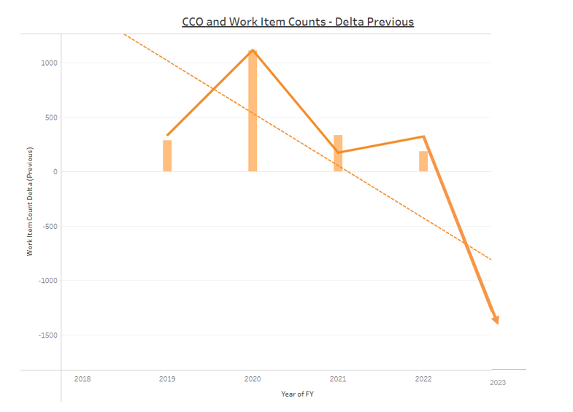
CSI/CCSI Usage vs Change Orders
Use of CCSI/CSI continues to drive down Change Orders for PMIA items

Slide 15
Integrated Requirements in
SAMM
Risk Assessed
Life Cycle Plan
OEM/TWH
OEM/TWH
85%
Condition Monitoring
CCSI
CSI
Regulatory/ PMP
PMSF
PMIA
Regulatory
Work Package
(higher risk)
Command Directed
Command Directed
Ship Generated
10%
Self Directed
SFWL
VRR
PPE Generated
Repairs
Deferred Work
(lower risk)
Material Assessments
Mission/ Sponsor
ABS COC/SC
Work Req.
T-ALT
Safety/ Regulatory
5%
Closed Loop Assessments
OERA
T-ALTs
POM input
C/E
Repair Officer
PPE
OPR: N7
Notes:
As a ship ages, maintenance, repair and alterations requirements continue to be generated from a variety of sources and analyses of ship condition. Risk is continuously assessed and the higher & med risk required M&R are completed by S/F (SAMM req maintenance, SF Repair) or contract support including Ship Repair Facilities (Repair & Alterations) and OEMs. Higher risk alteration requirements are submitted as TRANSALT Requests for PM Approval then designed and integrated into work packages. Lower risk items that cannot be completed due to budget, resource availability, etc. are deferred and submitted for POM input.
Focus on budgeting VS technical risk and Unfunded M&R

Slide 16
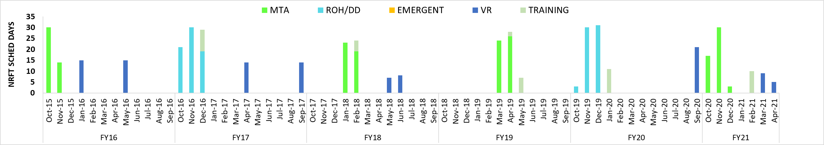
T-AO Fg Model and Maintenance Planning
Overlapping Planning Cycles
Planning/package Generation
MTA
ROH
Execution
Package
locked
Planning/package Generation
Package locked
Execution
Acquisition Timelines:
Deliberate ;
Not responsive
VR Period
0
Start
0
-60
Start
-212
Award
-30
Solicitation
Award
-228
Mission /CASREP Job C/O
-90
-296
Solicitation
Job Cut-off
-115
-356
Planning Con / Ship Check/PEVI
Final Package
-370
LLTM GFM
-150
-381
Planning Letter
Advanced Planning Letter
Notes:
Need the words that were spoken during brief in here. Admirals comment
+++++++++++++++++
This is a graphical portrayal of the Fg Model.
Starting left to right on a monthly basis to show the Fg Model over the course of 5 years.
The Green bars indicate a Mid Term Availability (MTA), the Light Blue indicate a Regular Overhaul (ROH)
The light Gray bars are preplanned training/ Ready for Sea periods
The Dark Blue bars indicate VR periods.
The progression of the maintenance periods show some of the variability of the schedule.
Also notice the overlapping Planning Cycles. We are planning at least one availability while another is going on. The presumption is that the intermittent one is executed and those job are completed prior to next one
Shown below the table with the Green and Bluecircles are the scaled planning and contracting POAMs for MTA/ROHs and VR periods respectively.
Please notice the timelines involved. The planning for one Avail occurs while the ship is conducting another.
There are also presumptions made that the work that is expected to be completed during the intervening VR periods will be completed and not put into the Maintenance package.
Or a final assessment of the material condition of something for a work item may be evaluated to determine the scope of that work item for planning prior to releasing the solicitation.
When a ship suffers a Casualty and pulls into port for emergent maintenance, intuitively one may think that this could suffice for a VR period, however due to Contracting restrictions and no planning, this maintenance will be limited solely to repair the casualty.
MSC generally does not have the flexibility to conduct additional maintenance during that period.
If one of these maintenance period is cancelled that planned work will then become growth onto the existing package eating the planned growth margin expected on open and inspect items planned during the avail.
This overall growth may be too much for the industrial capacity to absorb and result in extensions on the avail.

Slide 17
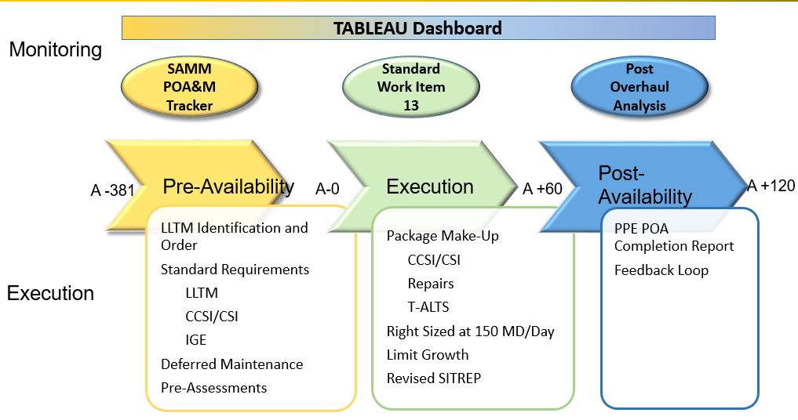
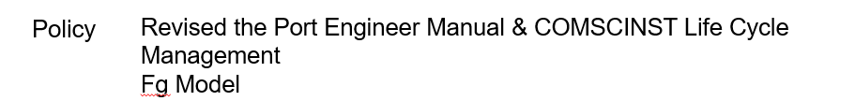
Shipyard Execution

Slide 18
Execution Support
実行サポート
Execution meetings and deliverables
実行会議と成果物
  Prior to the start of the availability
  メンテナンス期間の開始前
    A-40 Contract Award Meeting/Pre-Availability Execution Discussion with the SMT, Repair Yard, Pre-Arrival Conference
    A-40 SMT、修理工場、到着前会議との契約締結会議/契約締結前協議
  During execution
  実行中
    Daily production meeting, weekly progress meeting, weekly execution meeting with Program, Engineering, ABS, Contracting.
    毎日の生産会議、毎週の進捗会議、プログラム、エンジニアリング、ABS、契約社との毎週の実行会議。
  Post Overhaul
  分解修理後
    Post Overhaul Analysis Report, Ready For Tasking Letter (ROH), Lesson Learned Conference with OMT
    分解修理分析報告書、ROH（Ready For Tasking Letter）、OMTとの教訓会議
COMMUNICATION IS THE KEY TO SUCCESS

Slide 19
Execution Support
実行サポート
Project Planning and Monitoring
プロジェクトの計画と監視
  All government contractors shall provide production schedules to the gaining repair yard 7 days prior to the vessel arrival to incorporate into the integrated master schedule.
  すべての政府契約者は、統合マスタースケジュールに組み込むため、本船到着の7日前に、修理工場に作業スケジュールを提供しなければならない。
  Shipyard support work item, the government is developing a standard shipyard support work item for all government sub contractors.
  造船所支援作業項目、政府はすべての政府孫請け業者のための標準的な造船所支援作業項目を開発している。
COMMUNICATION IS THE KEY TO SUCCESS

Slide 20
Execution Support
実行サポート
Condition Found Reports and Contract Change Order (CCO) Support
コンディション・ファウンド・レポートと契約変更指示書（CCO）のサポート
  Complete all Regulatory structural and SOLAS Surveys within the first couple of weeks.
  最初の2、3週間以内に、すべての規制構造およびSOLAS調査を完了する。
  Submit Condition Found Reports as quickly as possible, send heads up to Port Engineer
  発見された状況報告書をできるだけ早く提出し、港湾技師に報告する
  Repair Yard shall respond to the CCO with a quote within 3 days of receipt.
  修理工場はCCOに対し、見積書を受領後3日以内に回答するものとする.
  Each CCO shall state if the additional work will result in a change in the schedule.
  各 CCO は、追加作業がスケジュールの変更につながるかどうかを明記するものとする.
COMMUNICATION IS THE KEY TO SUCCESS

Slide 21
Successful OEM /MSC Relationship
OEMとMSCの良好な関係
Reoccurring and Open communication between OEM and MSC:
OEMとMSCの間で繰り返されるオープンなコミュニケーション:
  Reoccurring Meeting to review
  定期的な検討会
    Market research request (part/service availability, T-ALT Scope, etc.)
    市場調査依頼（部品/サービスの有無、T-ALTスコープなど）
    Review status of awarded contracts (DO, TO, T-ALTs, etc.)
    受注した契約（DO、TO、T-ALTなど）の状況を確認する
    Discuss any MSC issues
    MSCに関する問題について話し合う
    Identify upcoming obsolescence
    今後の陳腐化を認識する
    Any OEM questions, concerns, or updates
    OEMに関する質問、懸念事項、最新情報
COMMUNICATION IS THE KEY TO SUCCESS

Slide 22
Successful OEM /MSC Relationship
OEMとMSCの良好な関係
Reoccurring and Open communication between OEM and MSC:
OEMとMSCの間で繰り返されるオープンなコミュニケーション:
  MSC provides the following in an effort to be more transparent in order for OEM to be more prepared and efficient:
  MSCは、OEMの準備と効率性を高めるため、より透明性を高める努力をして以下のことを提供する:
    MSC Availability Schedule (Fleet Maintenance Schedule Center – FSC)
    MSC修理スケジュール（船隊整備スケジュールセンター - FSC）
    Forecasted OEM Preventive Maintenance
    予想OEM予防保全
    Customer Feedback
    お客様からのフィードバック
COMMUNICATION IS THE KEY TO SUCCESS

Slide 23
Successful OEM /MSC Relationship
OEMとMSCの良好な関係
Reoccurring and Open communication between OEM and MSC:
OEMとMSCの間で繰り返されるオープンなコミュニケーション:
  OEM provides the following in an effort to help MSC improve and meet mission to maintain national security:
  OEMは、MSCが国家安全保障を維持するための使命を果たし、向上するのを支援するために、以下のものを提供する:
    Obsolescence Forecast
    陳腐化予測
    Industrial Knowledge
    産業知識
    Industrial Feedback
    産業界からのフィードバック
COMMUNICATION IS THE KEY TO SUCCESS

